Slide 1
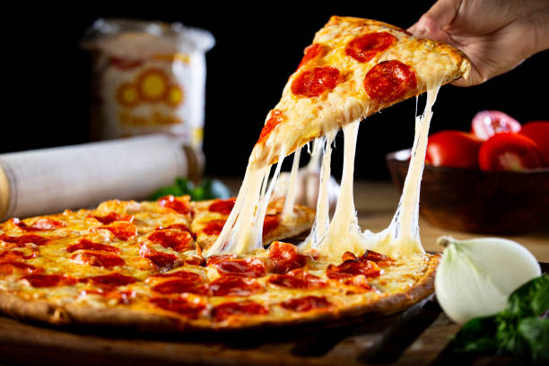
SQL Project PIZZA BOX CAR

Slide 2
PROJECT SUMMARY
01.) objective 03.) About the dataset
To analyze pizza sales data to: ->Analyze sales records from a pizza
-> provide actionalble insights restaurant, spanning one year.
On sales performance. -> Dataset has 48,620 sales transaction
-> customer preferences and to analyze.
Revenue generation.
02.) Features of the topic
->Sub Query 04.) Tools Used
->Group By ->MySQL for data querying and manipulation.
->Cumulative Sum
->Visualizations

Slide 3
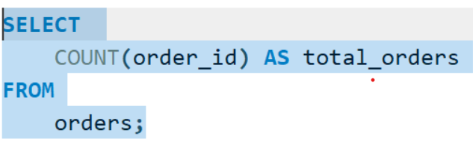
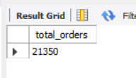
Retrieve the total number of orders placed.

Slide 4
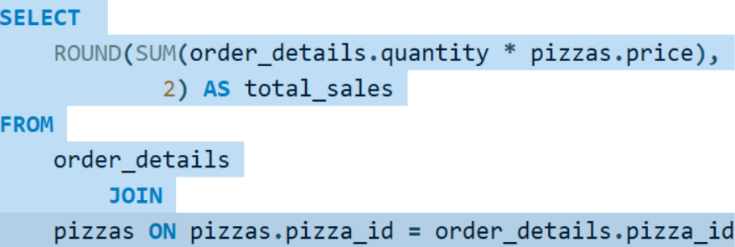
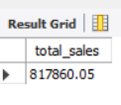
Calculated the total revenue generated from pizza sales.

Slide 5
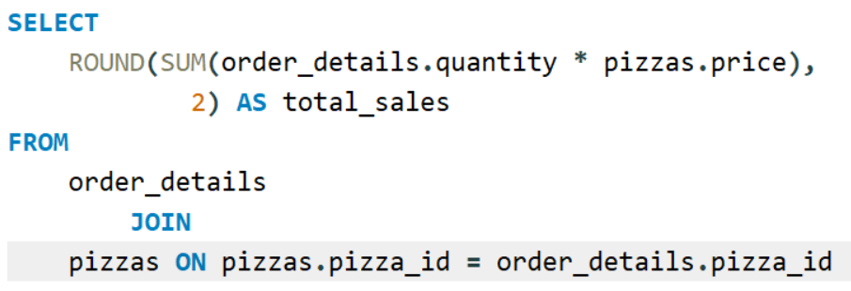
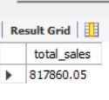
Identify the highest-priced pizza.

Slide 6
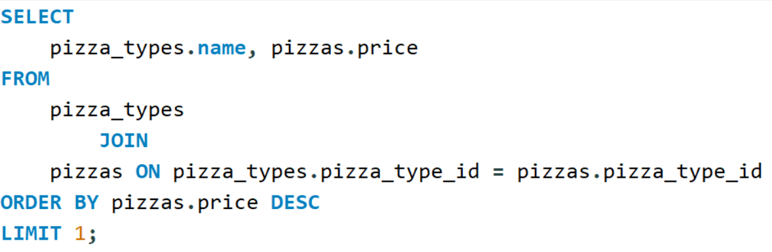
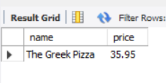
Identify the highest-priced pizza.

Slide 7
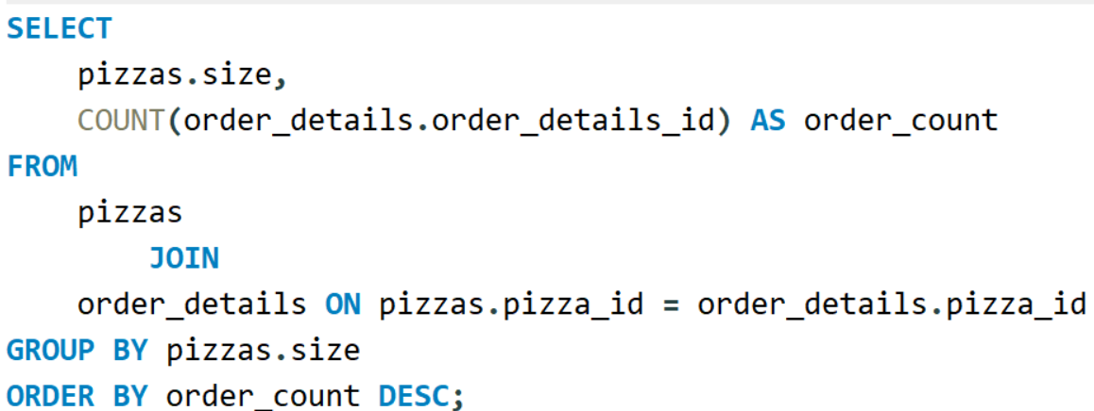
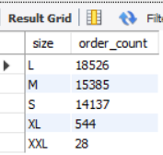
Identify the most common pizza size ordered.

Slide 8
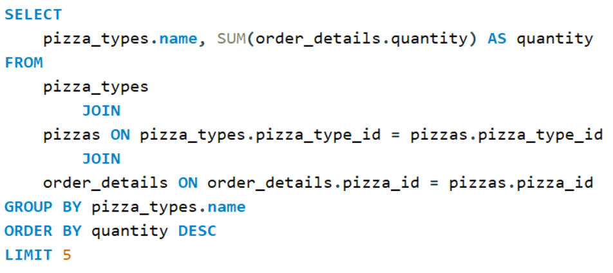
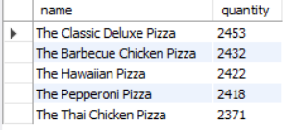
List the top 5 most ordered pizza types along with their quantities.

Slide 9
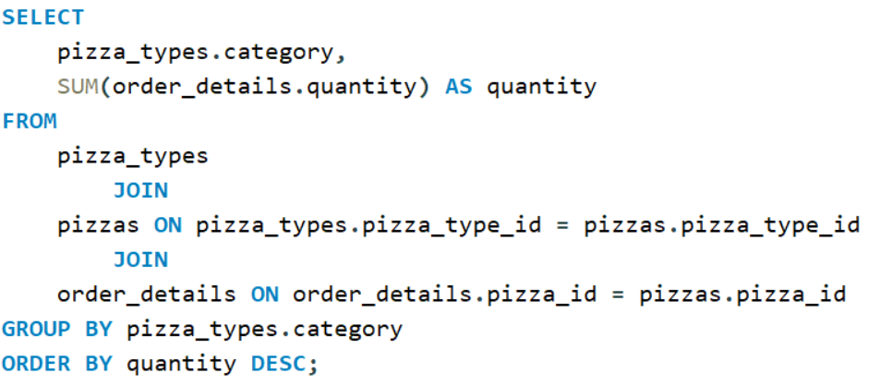
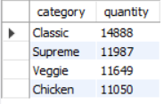
Join the necessary tables to find the total quantity of each pizza category ordered.

Slide 10
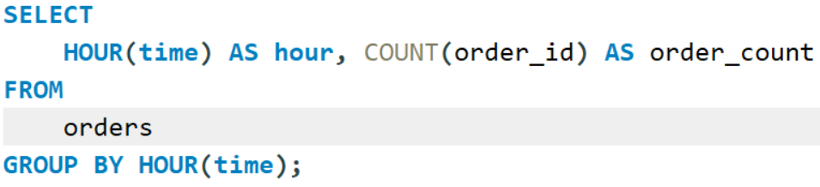
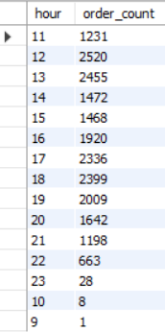
Determine the distribution of orders by hour of the day.

Slide 11
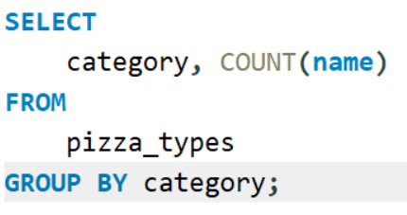
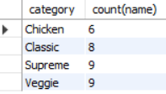
Join relevant tables to find the category-wise distribution of pizzas.

Slide 12
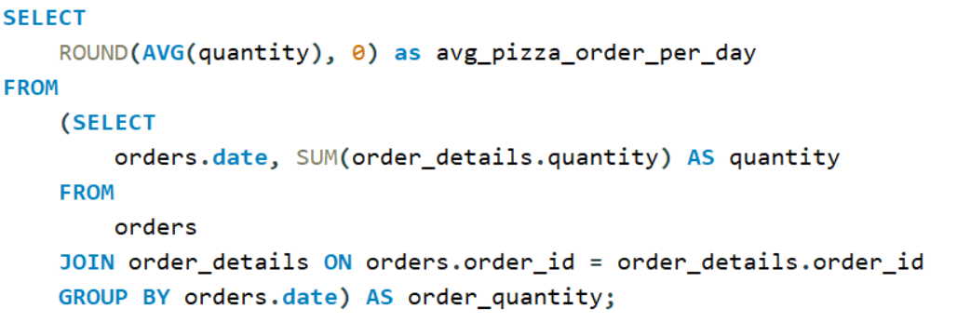

Group the orders by date and calculate the average number of pizzas ordered per day.

Slide 13
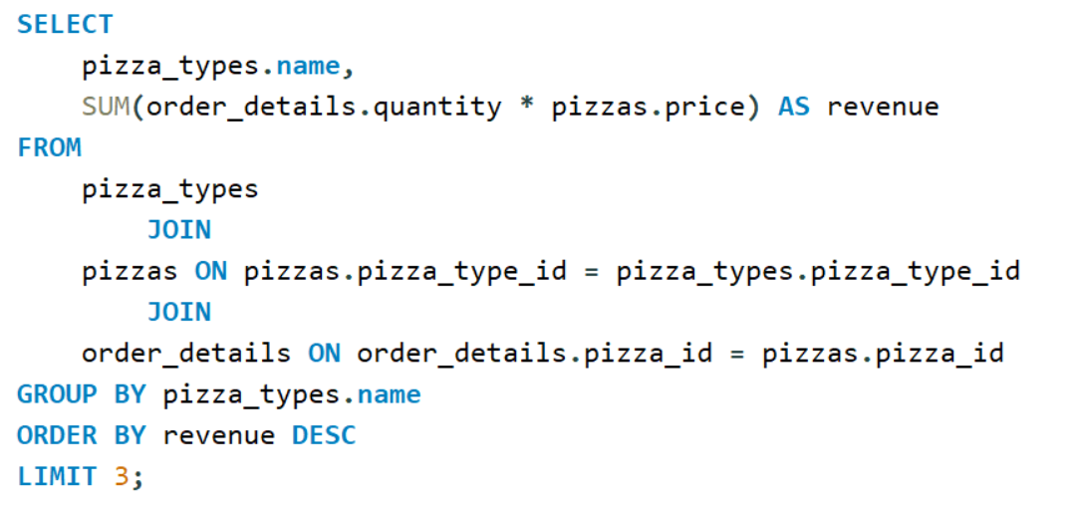

Determine the top 3 most ordered pizza types based on revenue.

Slide 14
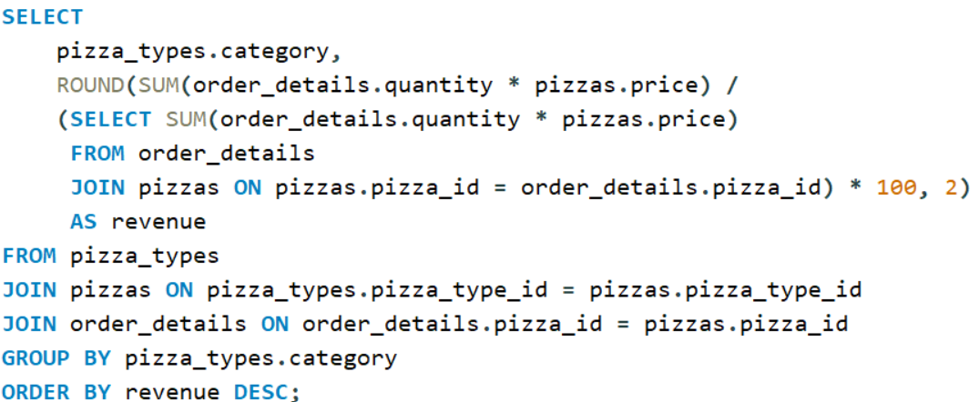
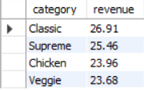
Calculate the percentage contribution of each pizza type to total revenue.

Slide 15
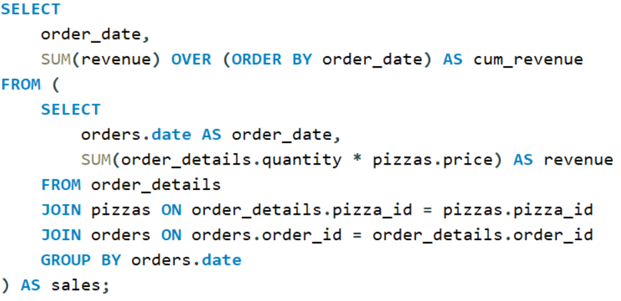
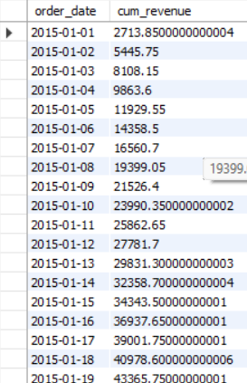
Analyze the cumulative revenue generated over time.

Slide 16
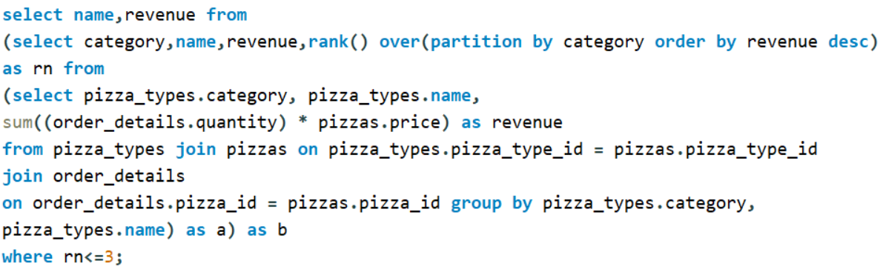
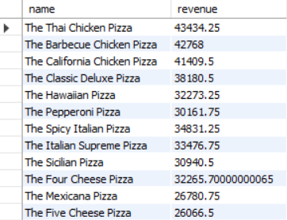
Determine the top 3 most ordered pizza types based on revenue for each pizza category.

